Slide 1
BCCA figures
March 13 2025

Slide 2
Data % to report
X2.1.Flow.Type n prop
<chr> <int> <dbl>
1 Biotic 113 0.551
2 Human movement 21 0.102
3 Physical 38 0.185
4 Sociocultural 33 0.161

Slide 3
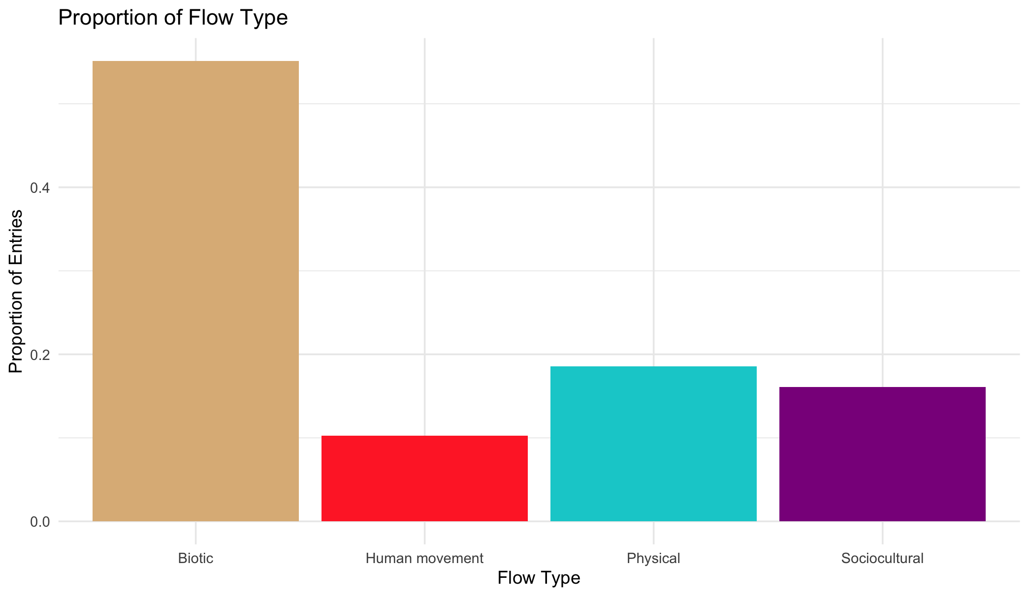

Slide 4
Multiple flows
Another.Flow. n prop
1 No 168 0.820
2 Yes 37 0.180

Slide 5
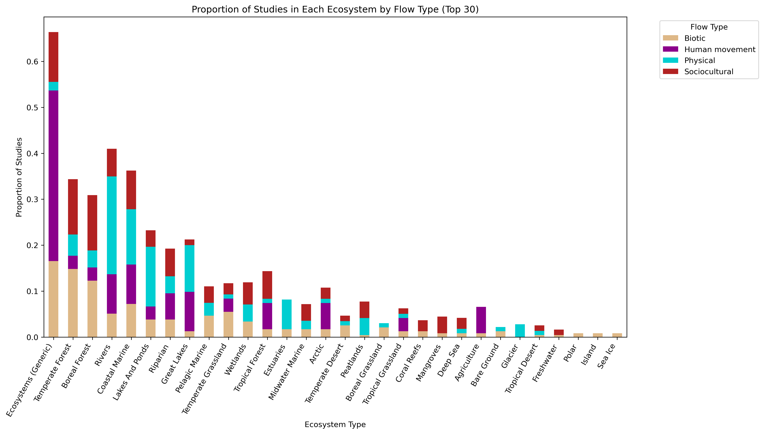
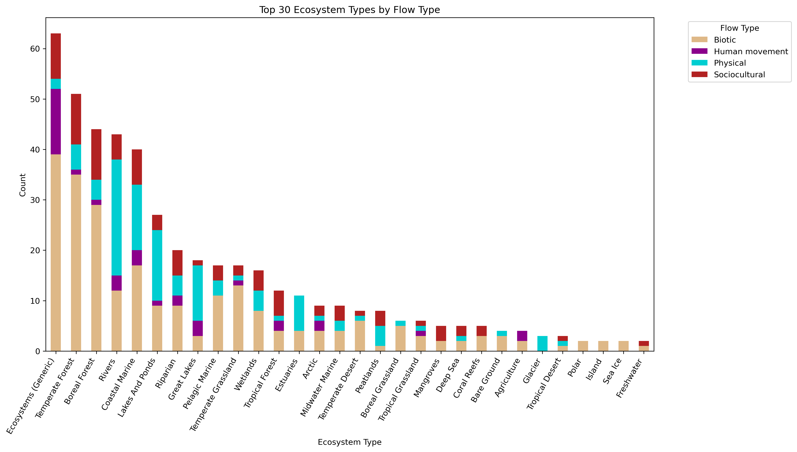

Slide 6
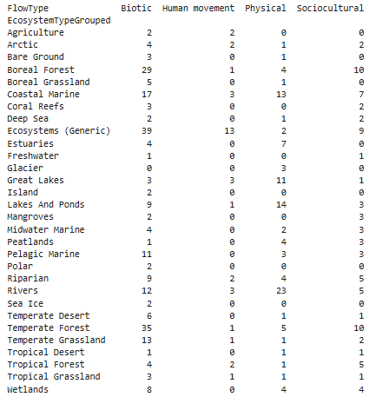
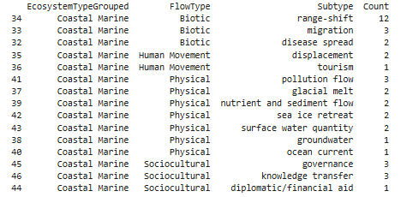

Slide 8
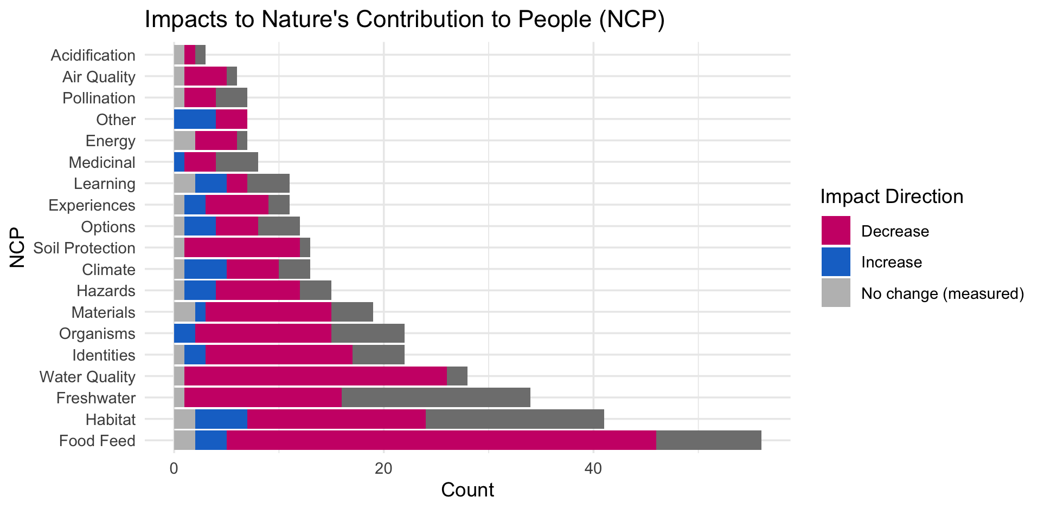

Slide 10
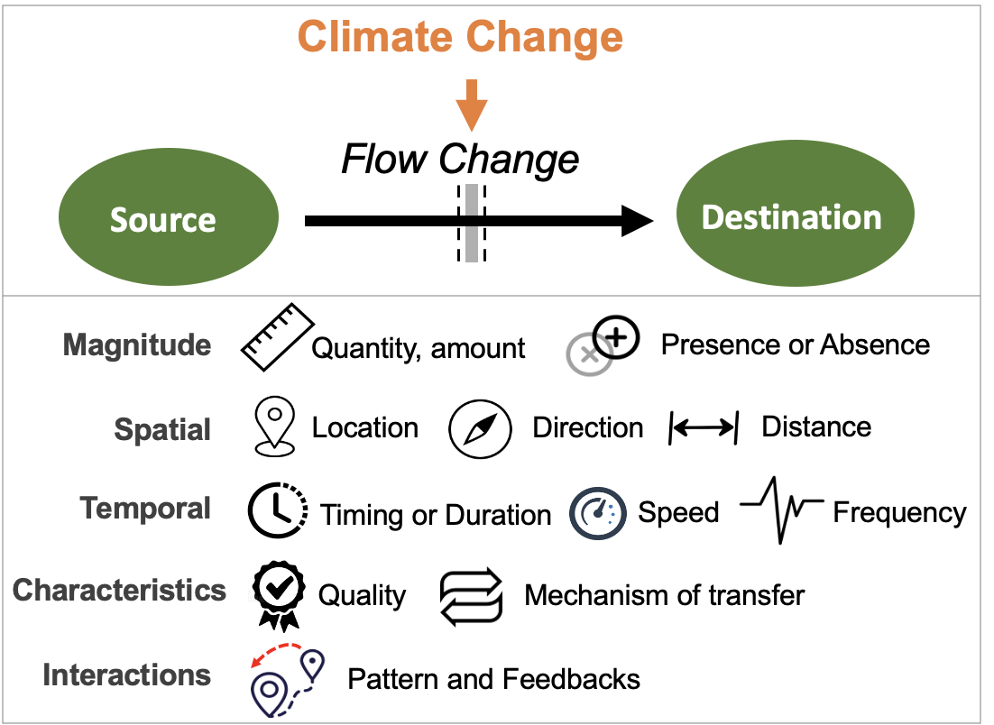
Most common paths
Climate change →

Slide 11
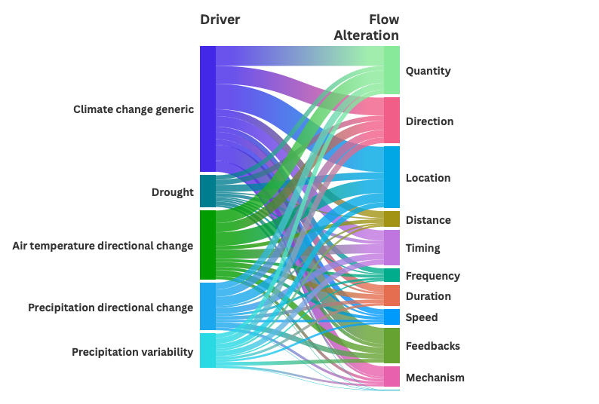

Slide 13
OLDER:

Slide 15
At least 5 entries – top – to get stats on % of entries or papers on these:

Slide 16
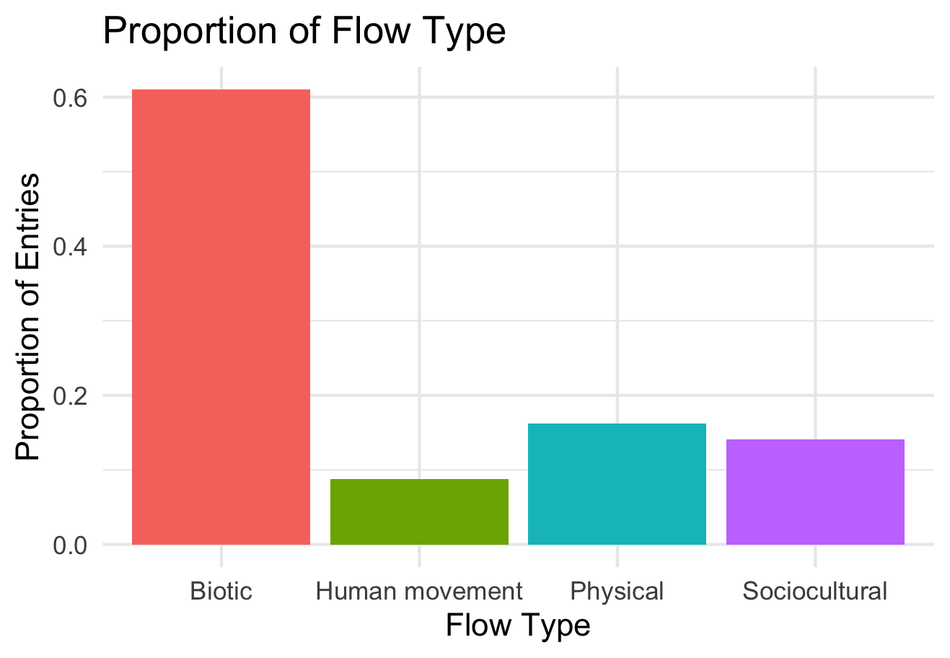

Slide 17
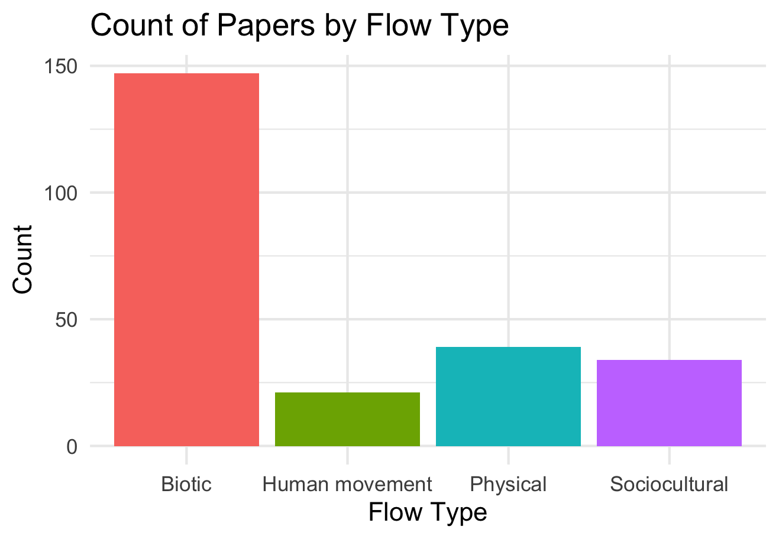

Slide 18
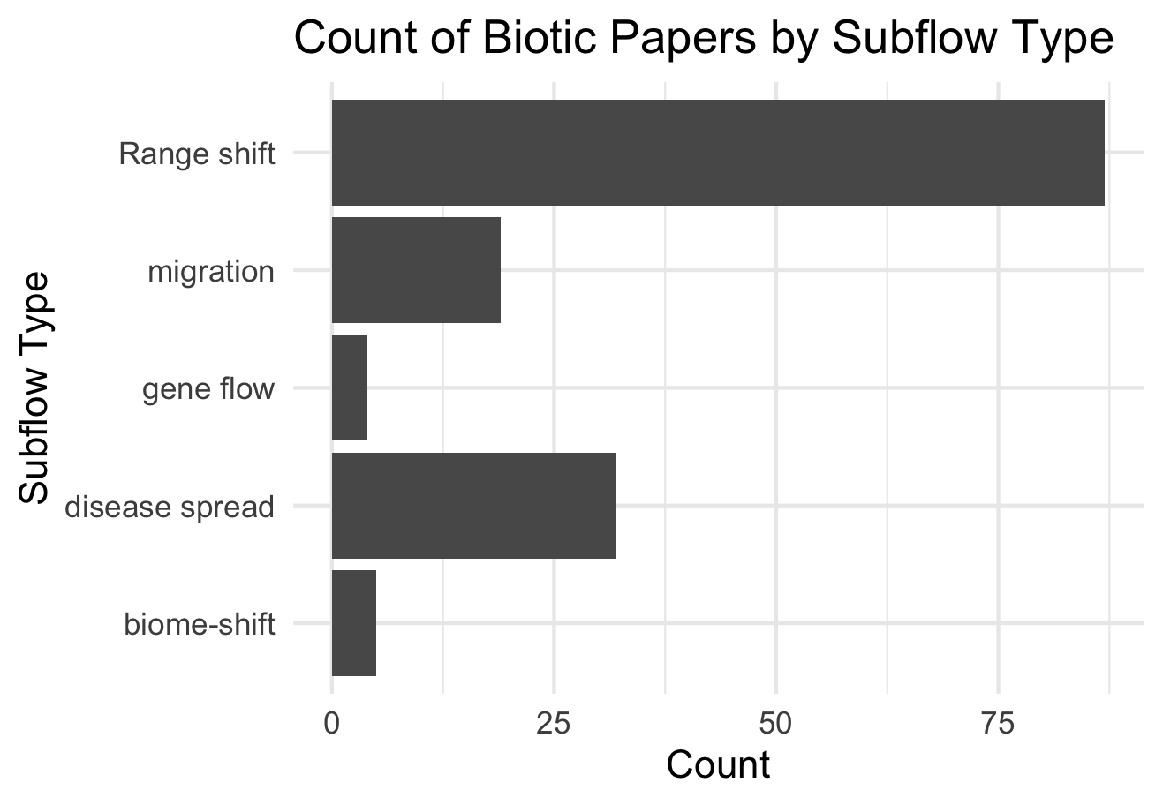

Slide 19
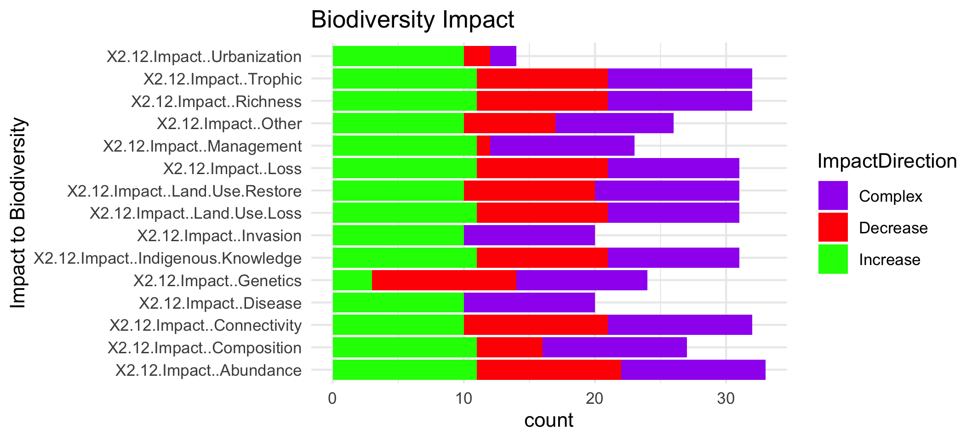

Slide 21
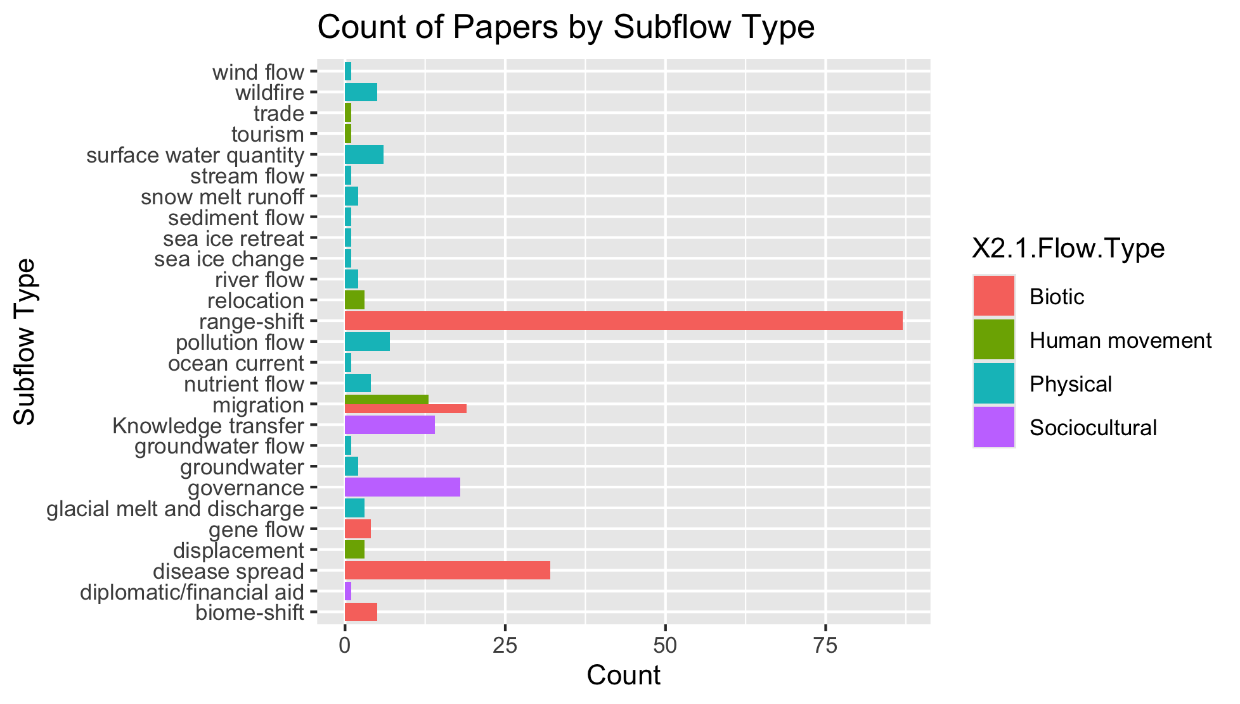
To group physical flow papers

Slide 22
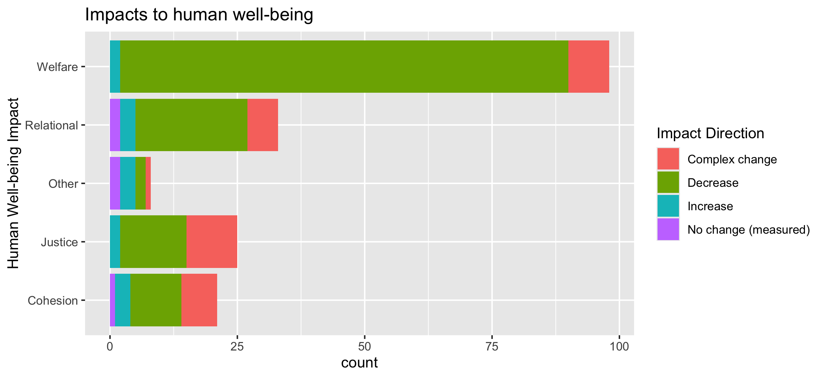
To align direction colors with final color pallet

Slide 23
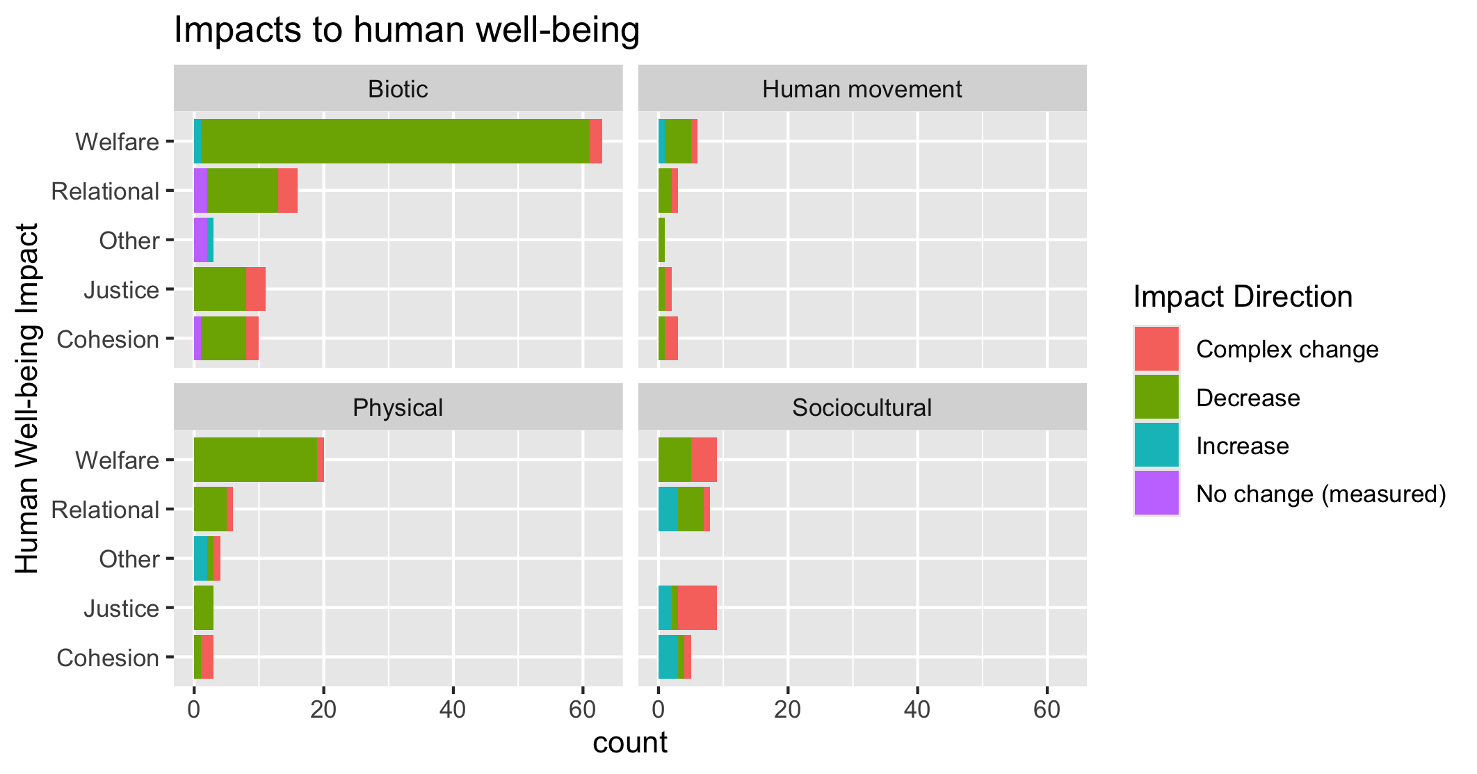
To align direction colors with final color pallet

Slide 24
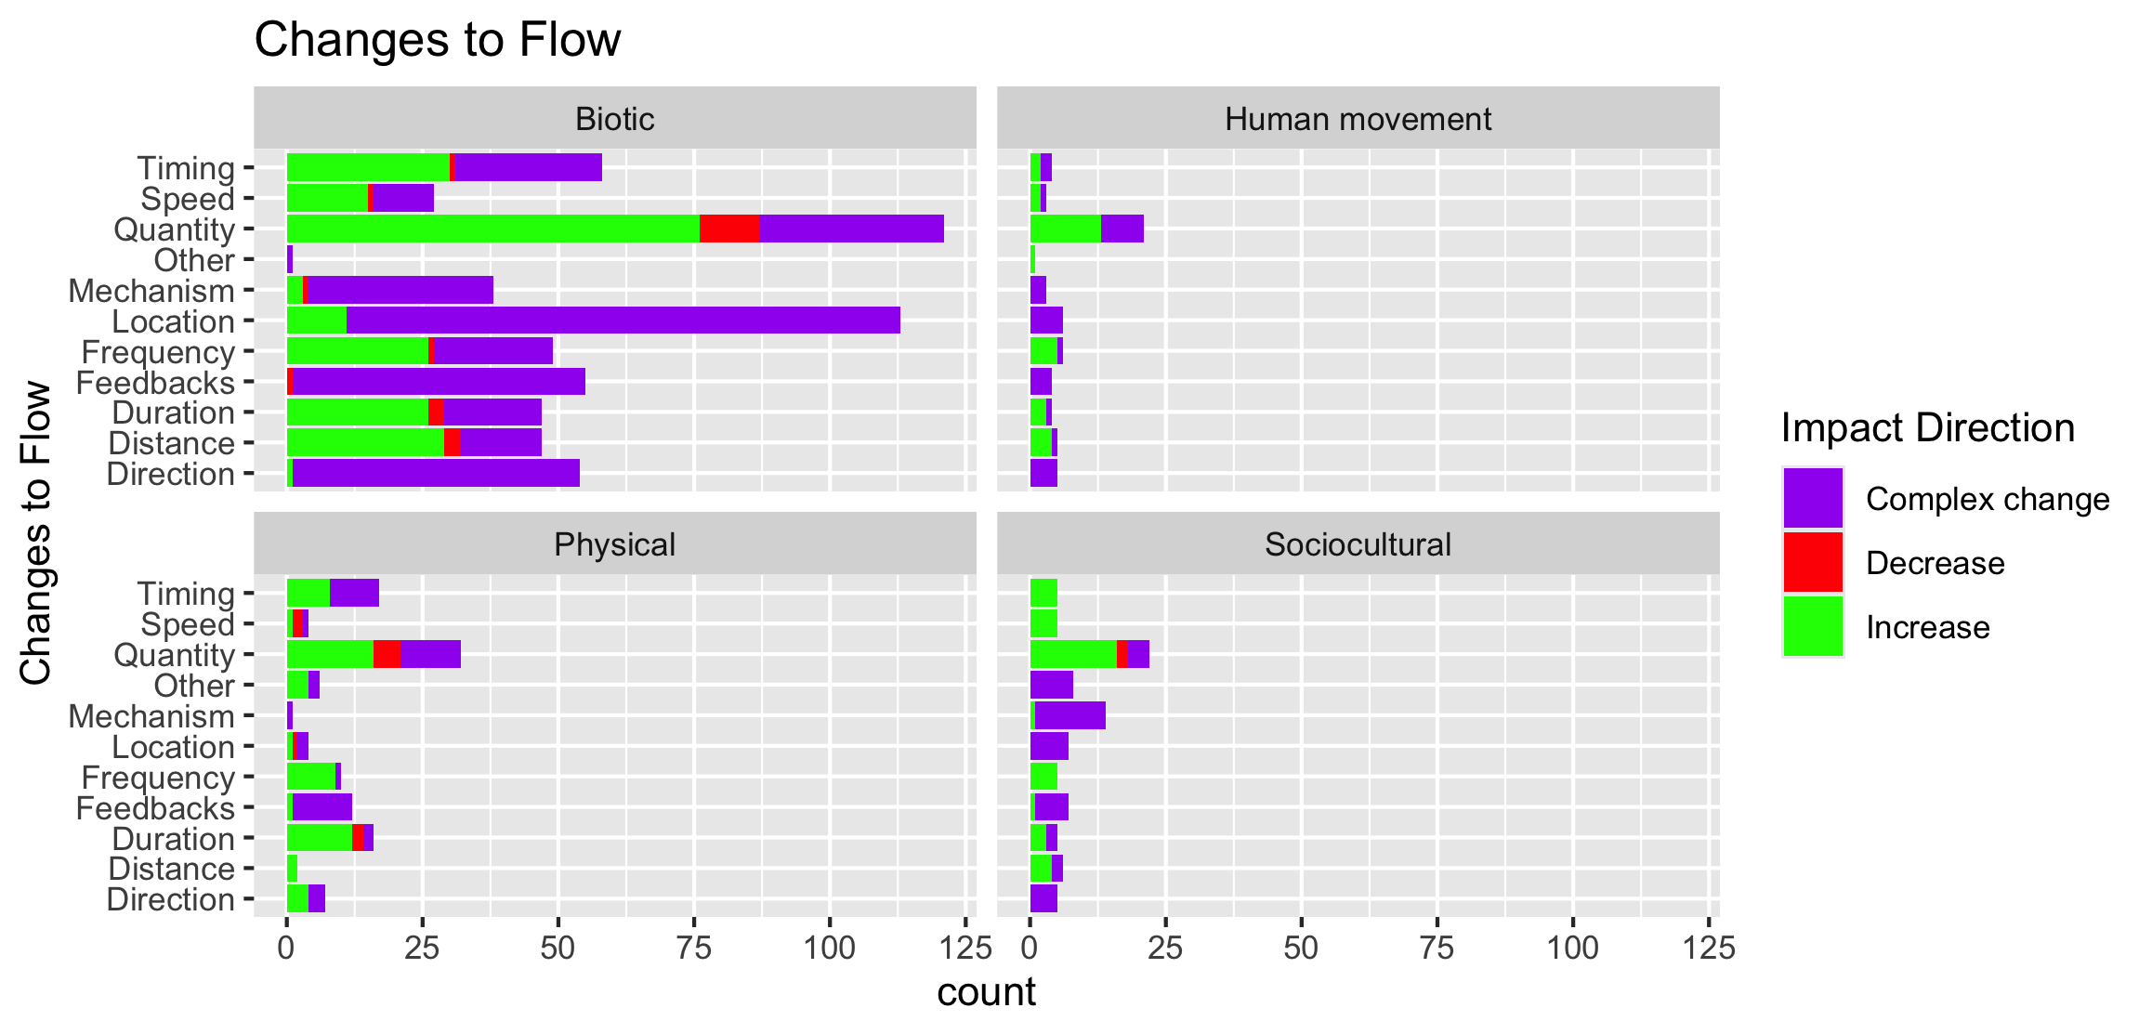

Slide 25
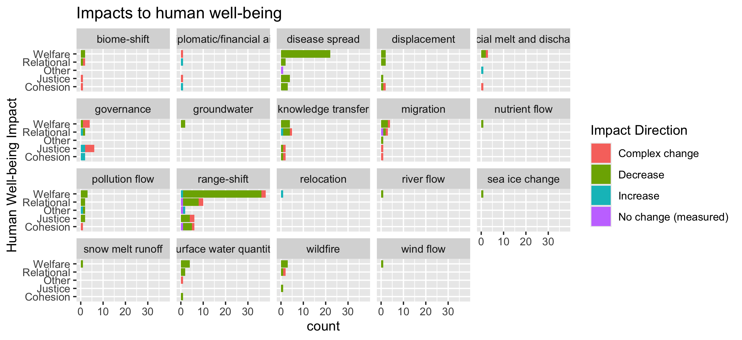
To group physical flow papers

Slide 26
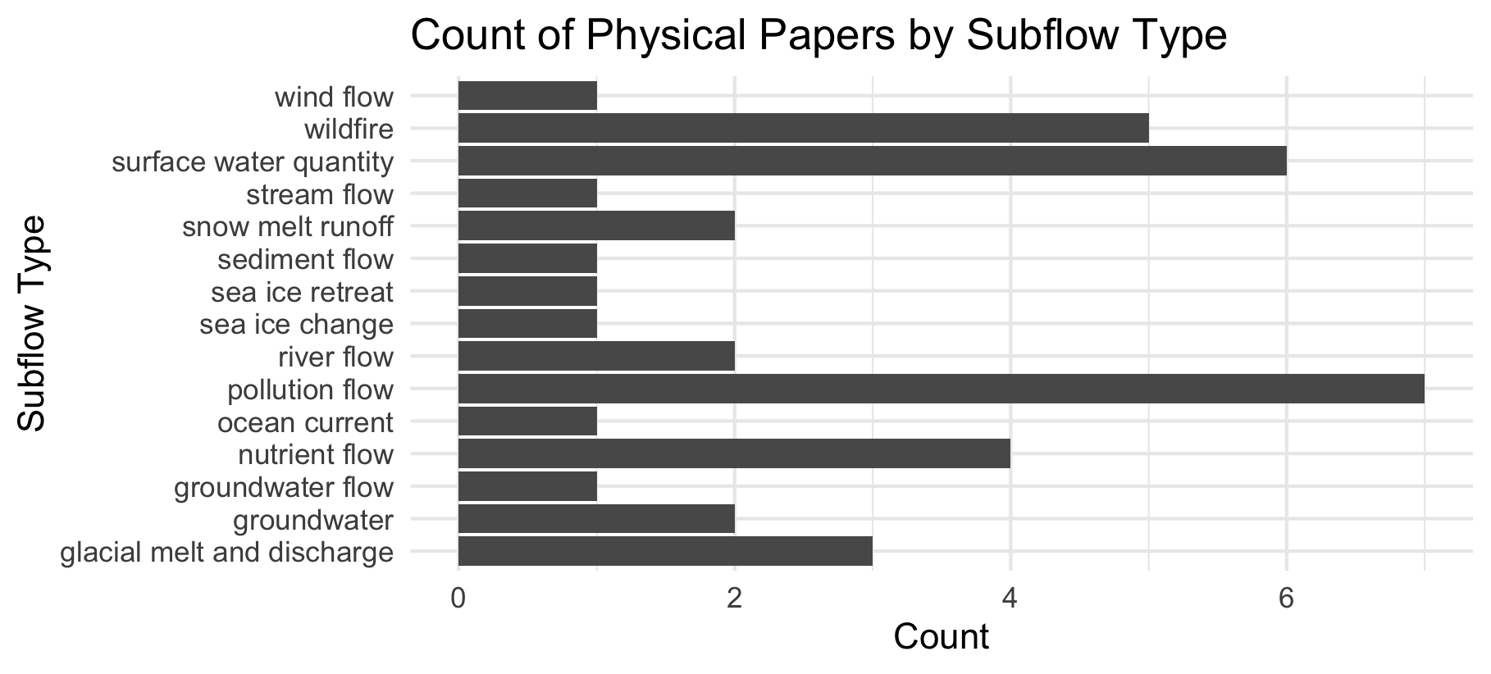

Slide 27
Feb 23 2025

Slide 28
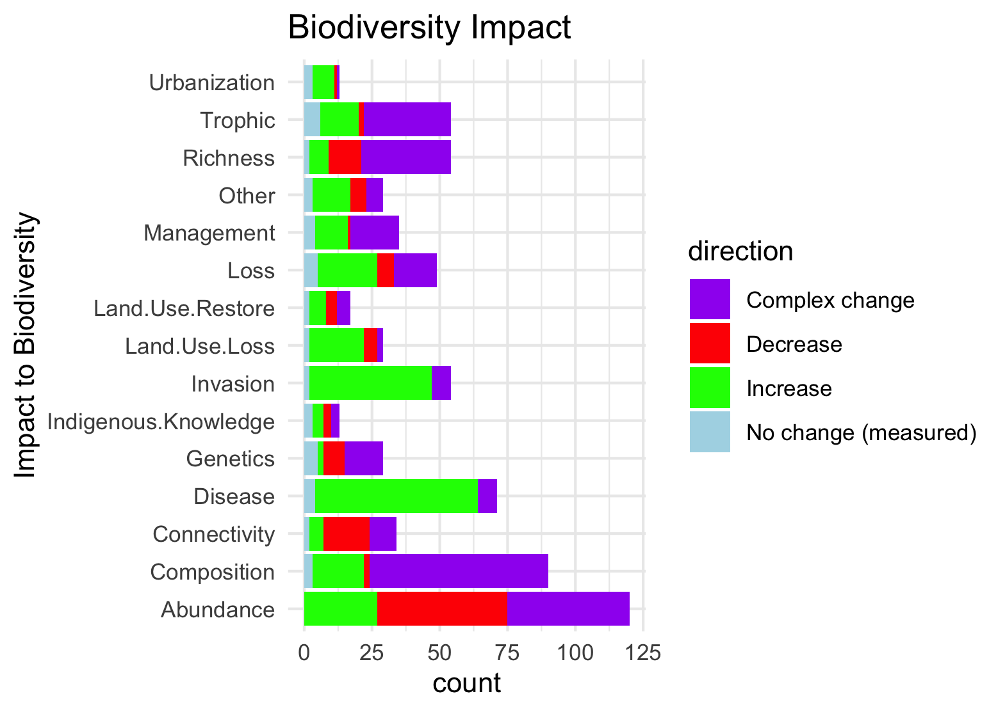
Needs to be grouped by what is good and what is bad to see increase in:

Slide 29
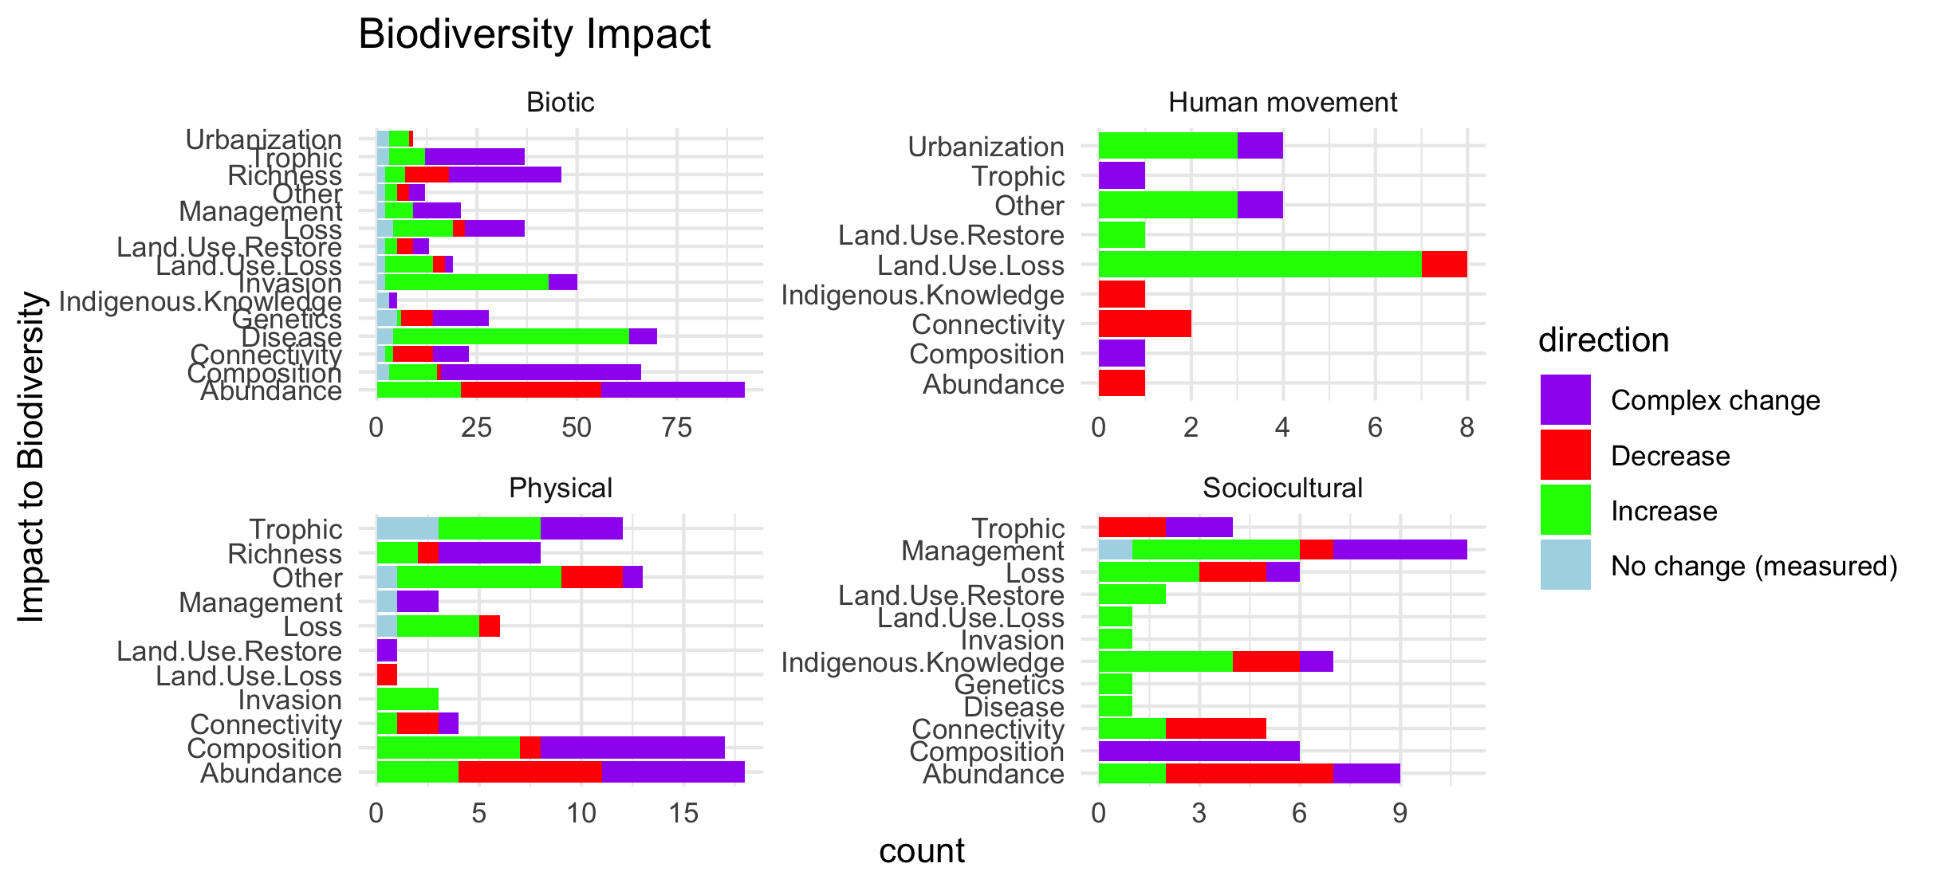
Scale free on the facet (diff x axis)

Slide 30
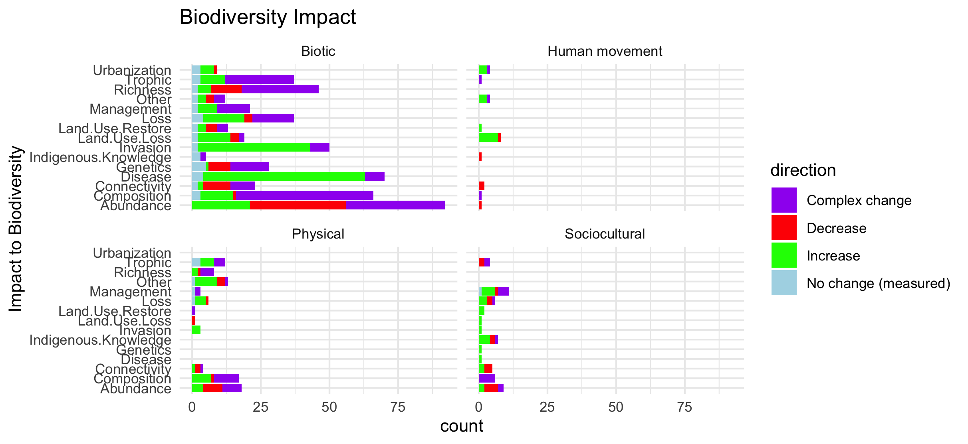
Scale fixed on the facet (same x axis)

Slide 31
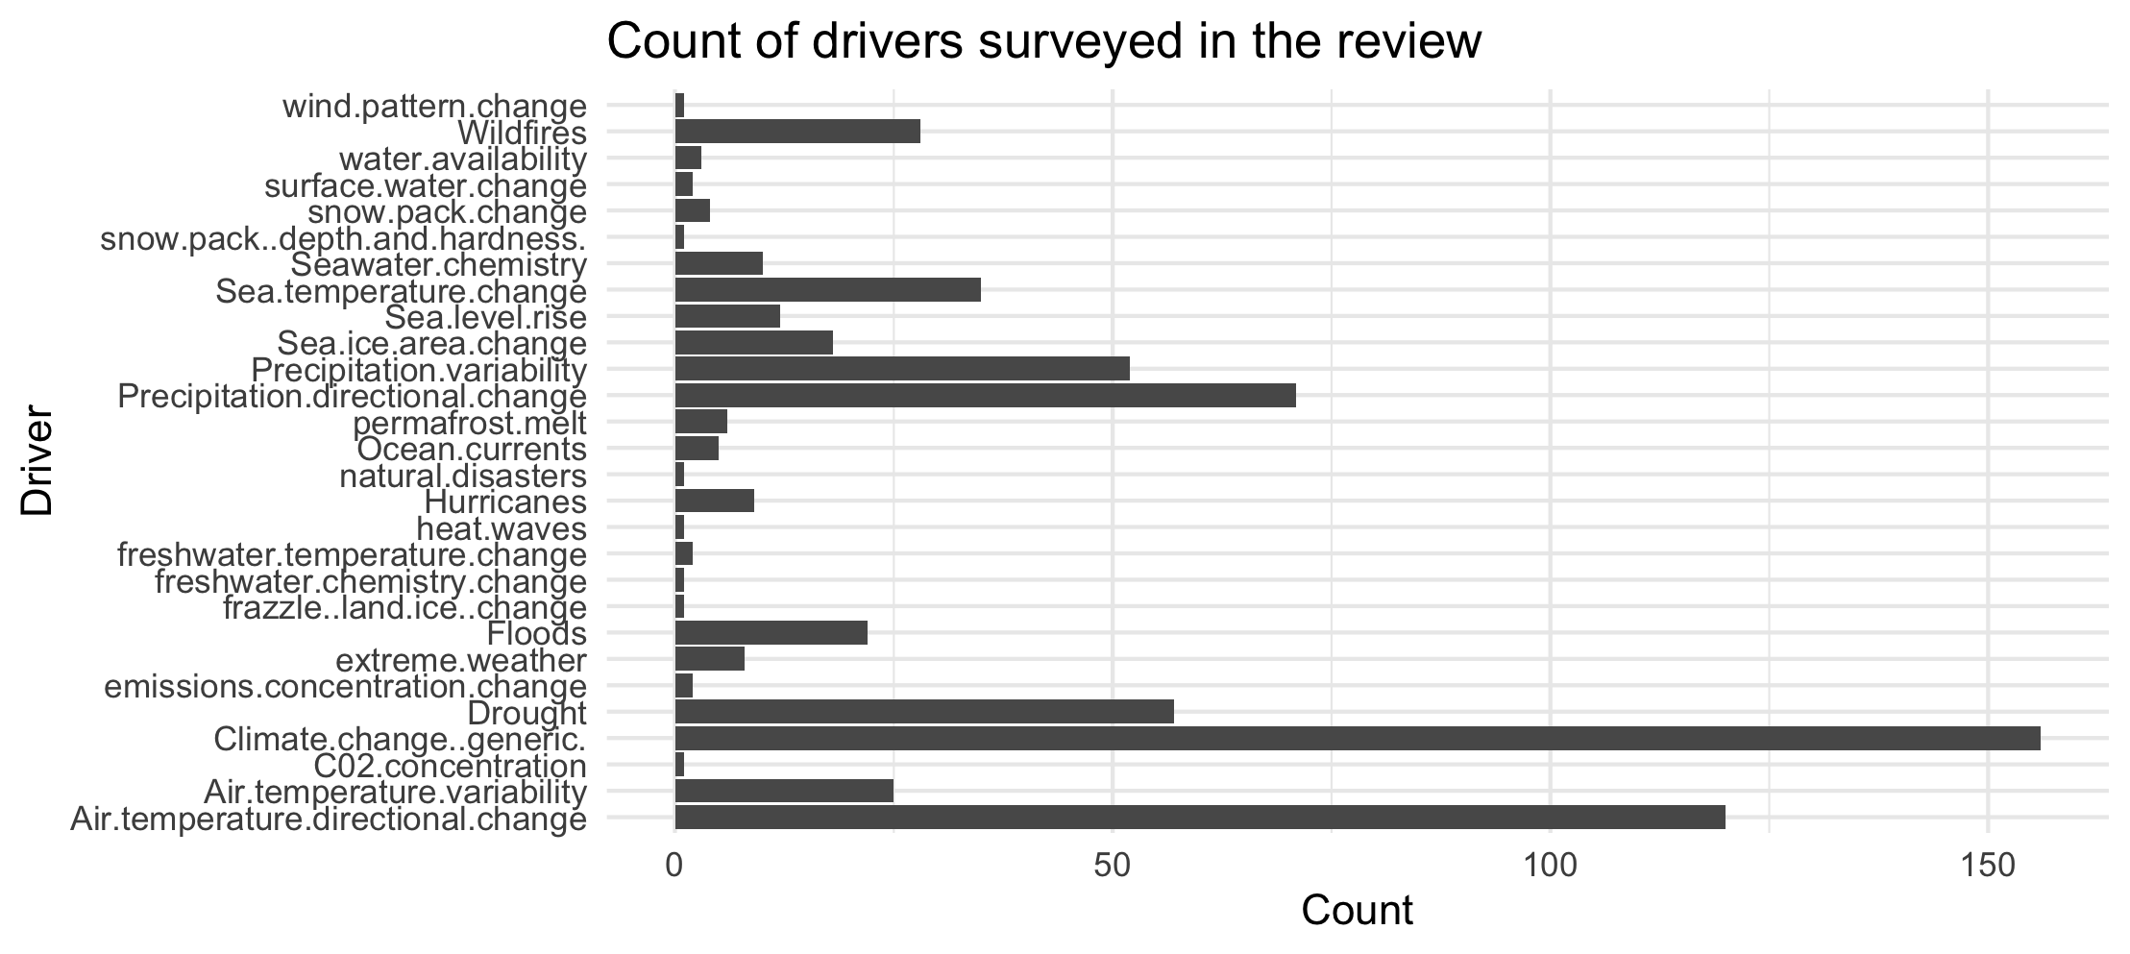

Slide 32
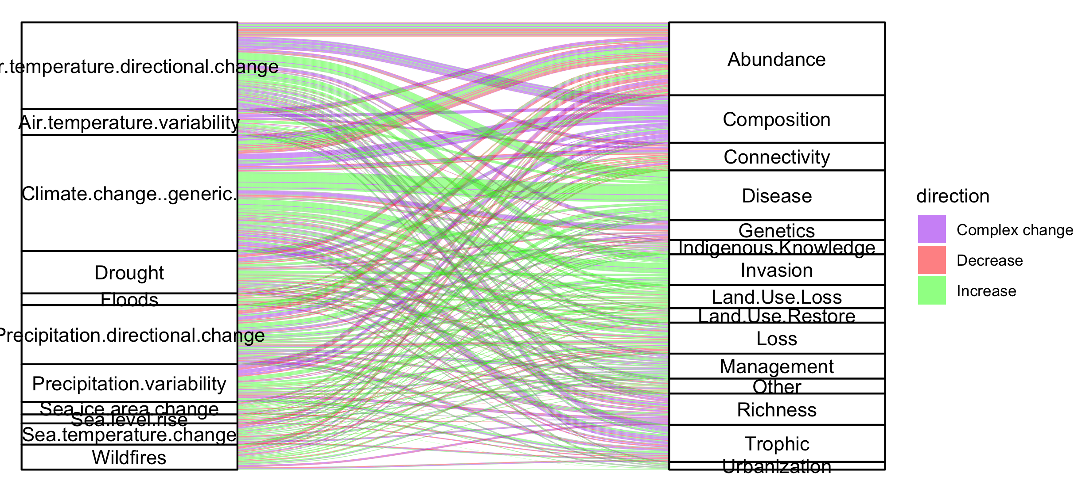
Colleen: see note isn the code – we could group spme of the drivers (hurricaines, extreme weather, ands ome of the ice ones). This still doesnt take into account if changes arw good or bad though and might just be too busy.

Slide 33
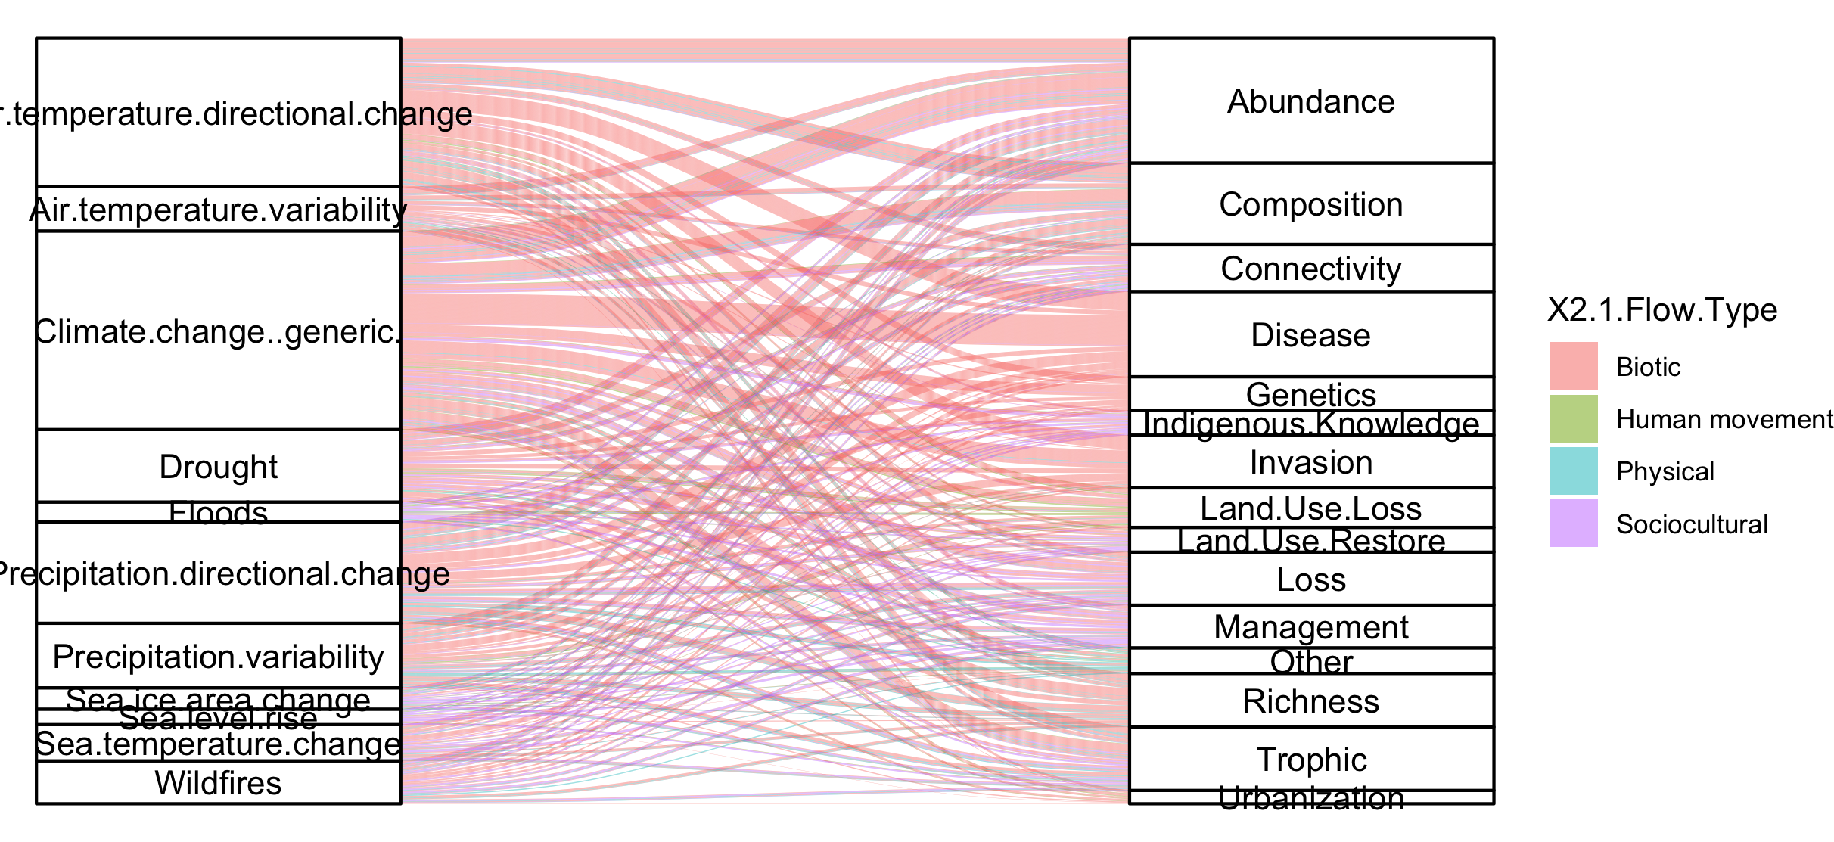
#not that informative because so many more of the papers are biotic

Slide 34
NCPs

Slide 35
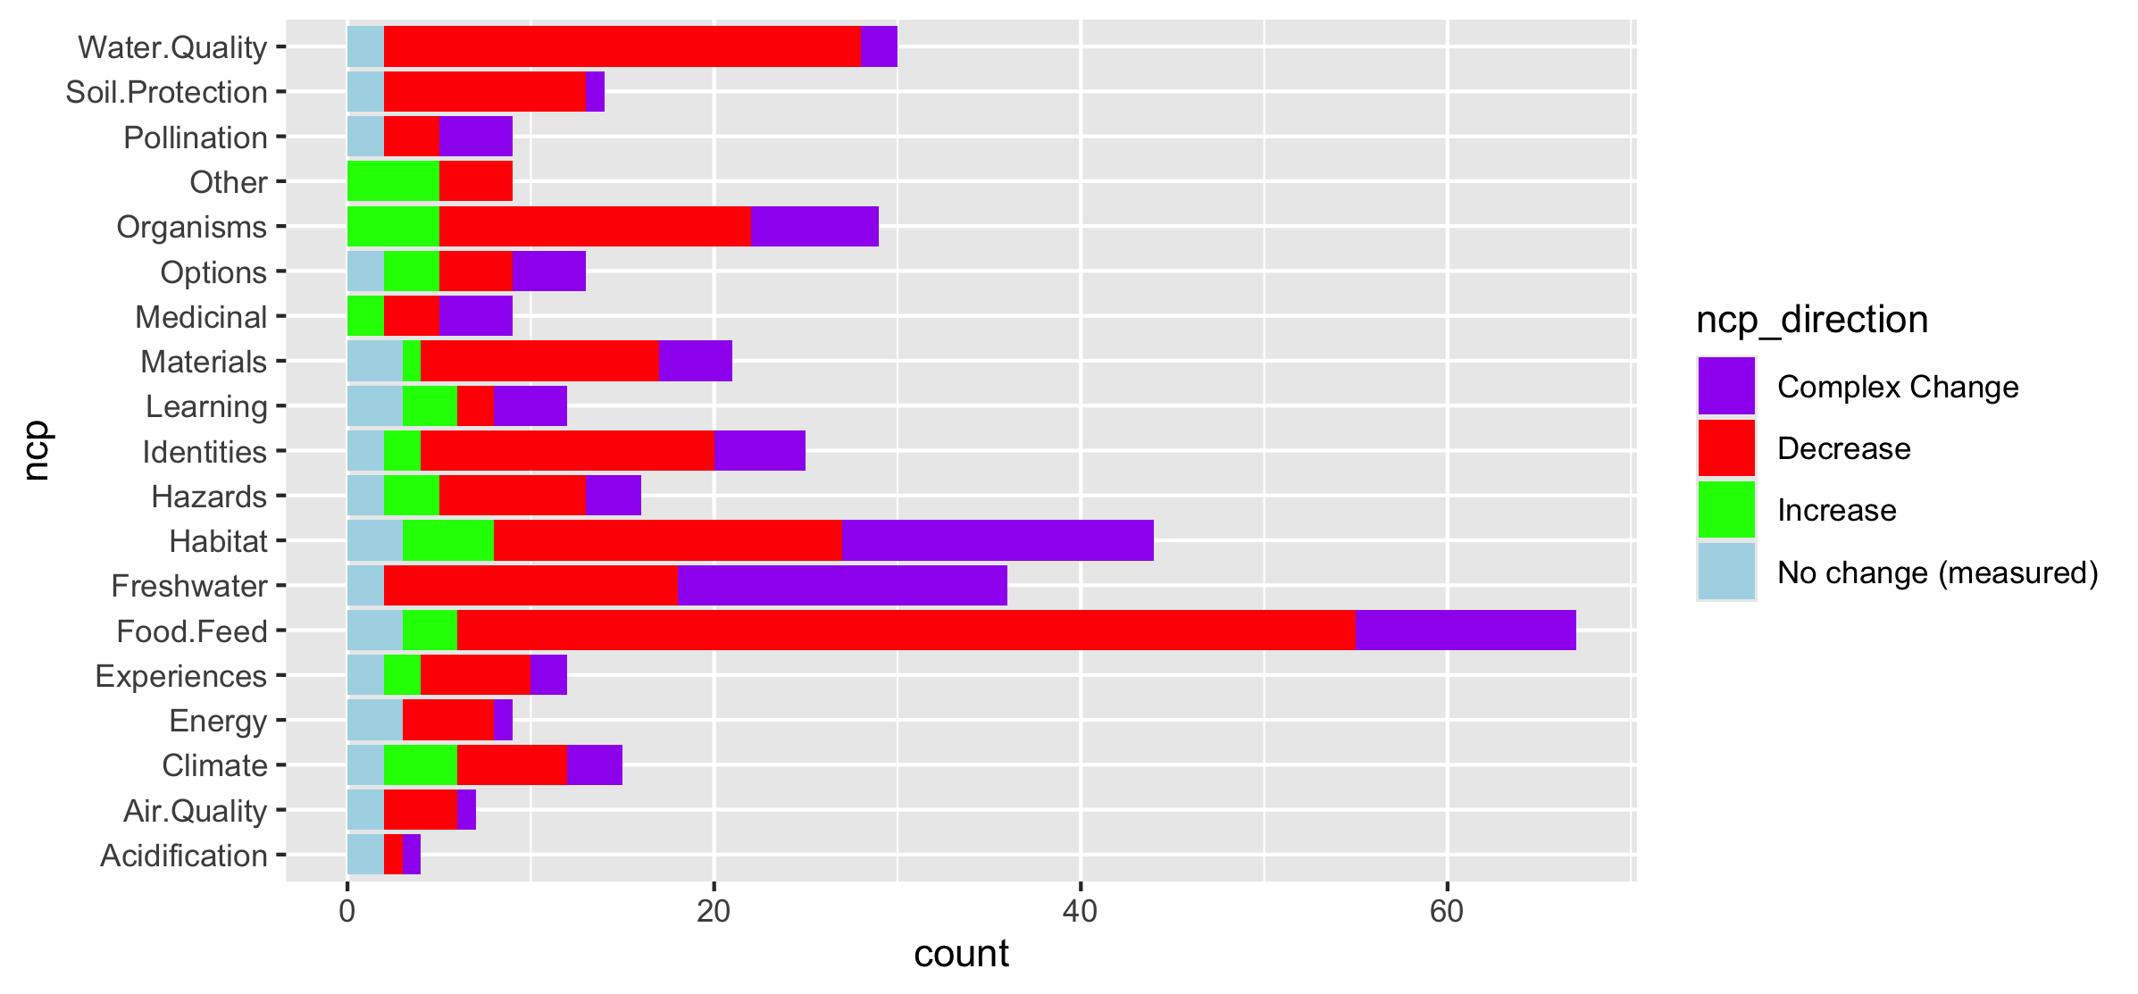
Fix labels

Slide 36
Do by flow type

Slide 37
Fix labels

Slide 38
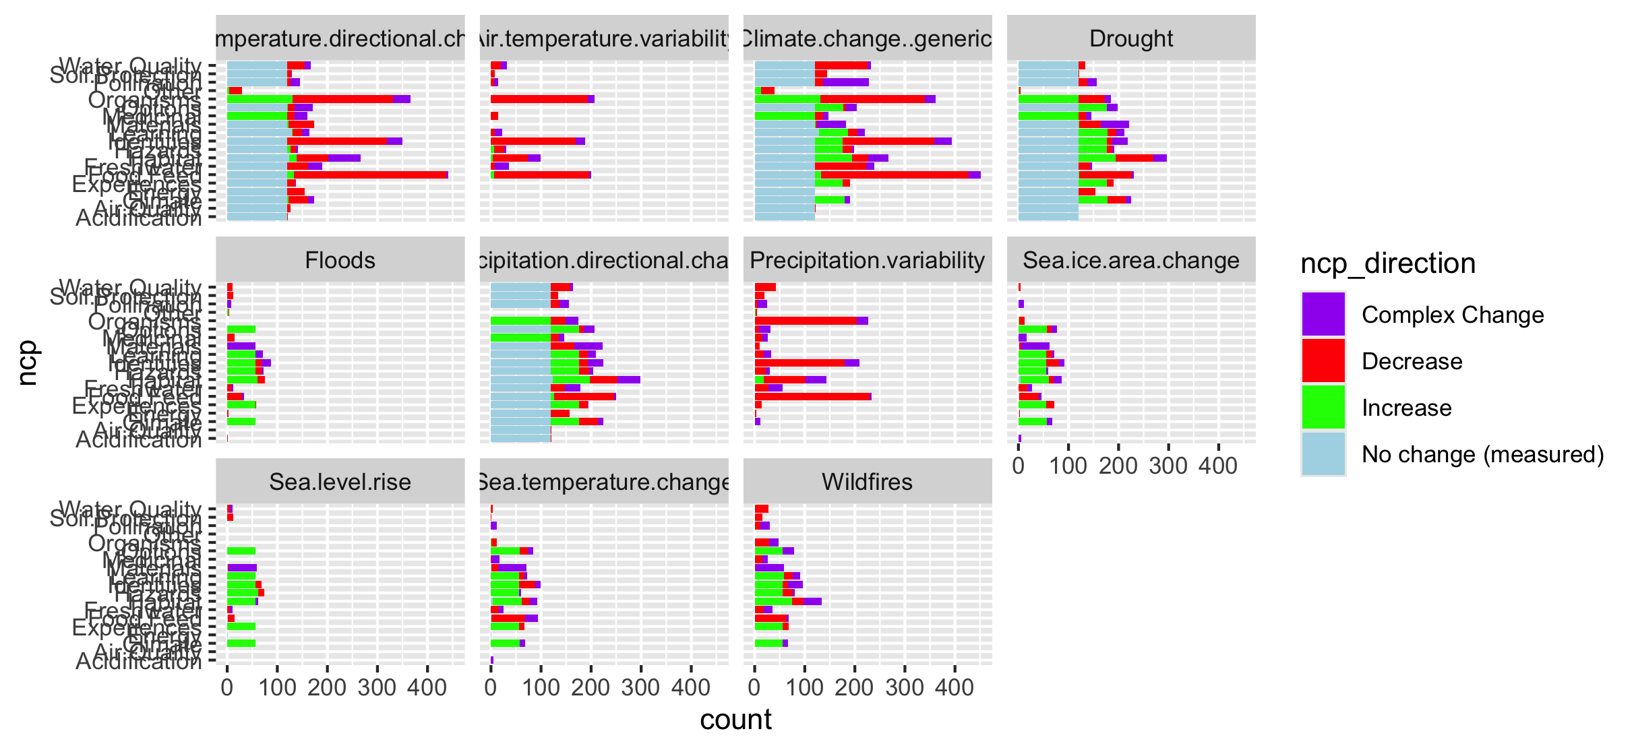

Slide 39
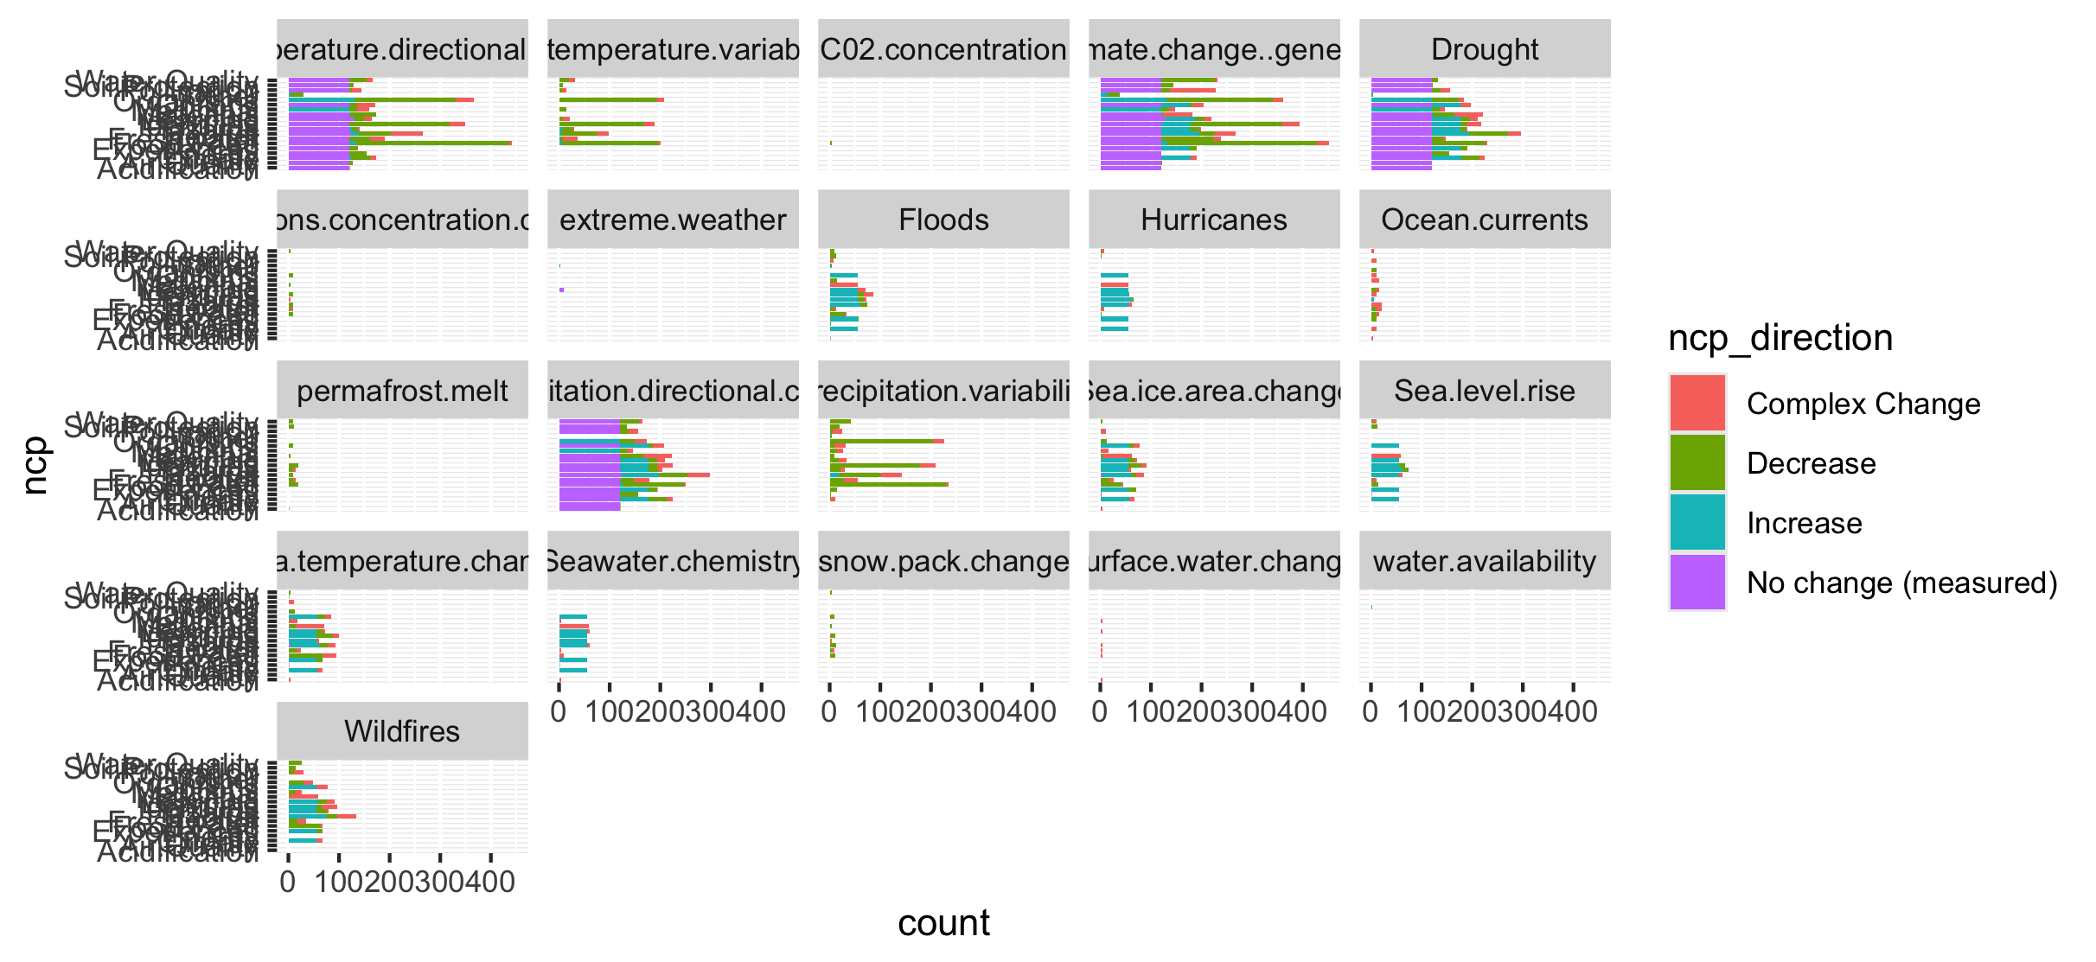
Too many drivers

Slide 40
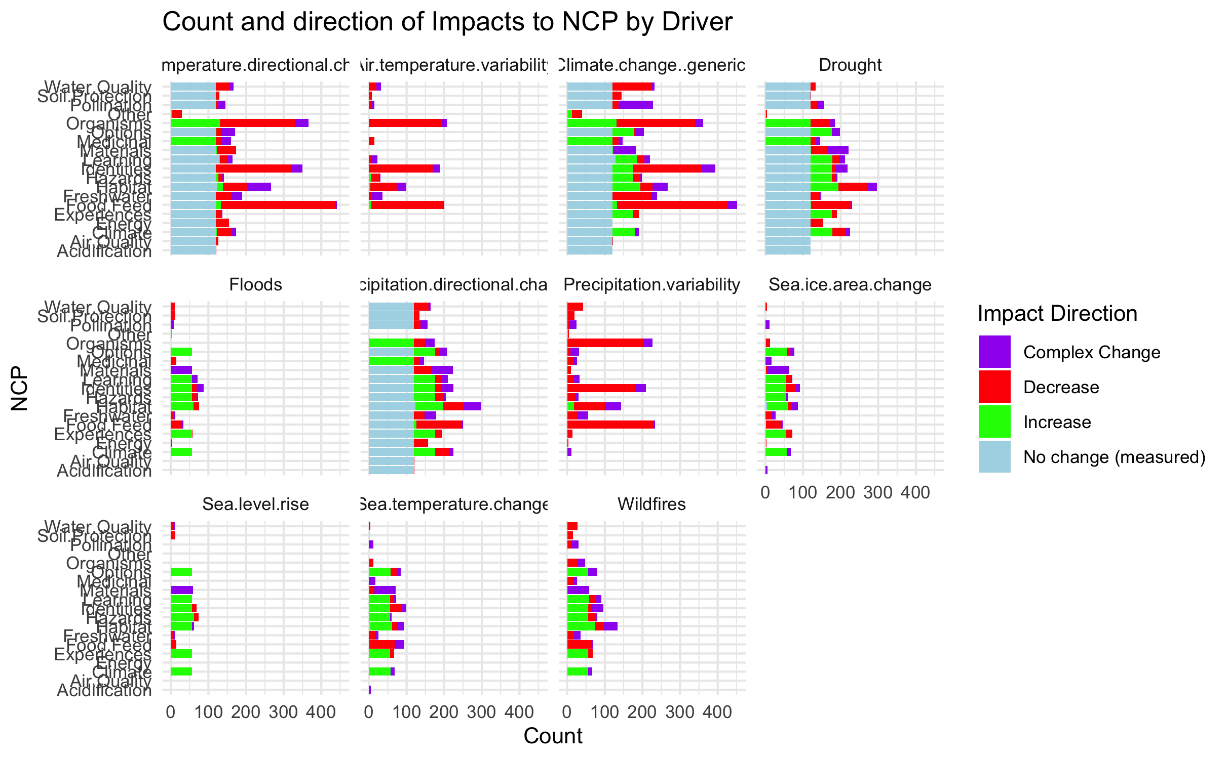

Slide 41
HWB

Slide 42
Connections – how does altered flow relate
Driver~ altered flow (by flow, and subflow – grouped out by flow
Altered flow~ impact (for each category)

